Slide 1
Final-Presentation: An Algorithm to Improve Image Registration for a Piecewise Planar World
Bo Cao (KIT)
Supervisor: M.Sc. Bastian Erdnüß (IOSB)
Examiner: Prof. Dr. Ralf Mikut (IAI) and PD Dr.-Ing. Markus Reischl (IAI)

Slide 2
Agenda
Introduction
Background
Method
Evaluation

Slide 3
Goal
invent a new algorithm to improve image registration for a piecewise planar world.
Result
compatible homographies between multiple plane patches in an image pair.
Future Work
following the camera path
camera calibration
3D reconstruction

Slide 4
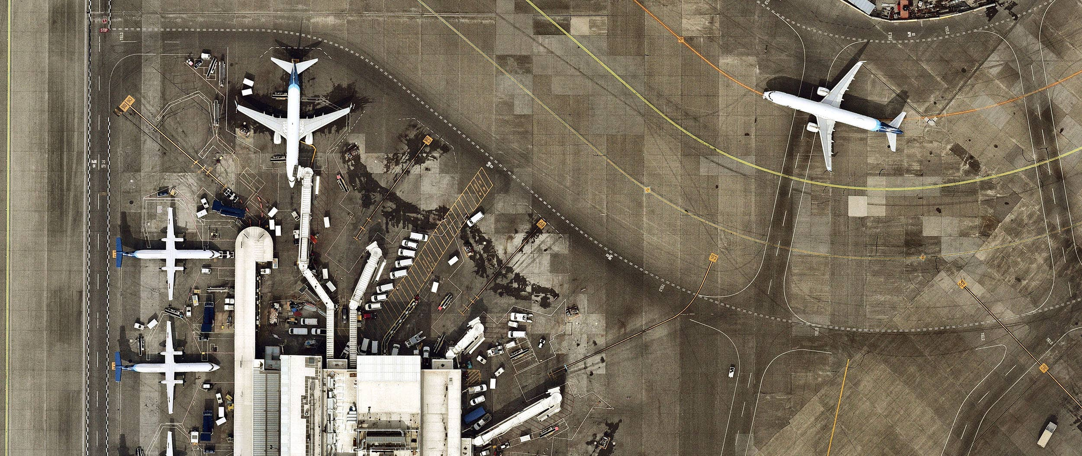
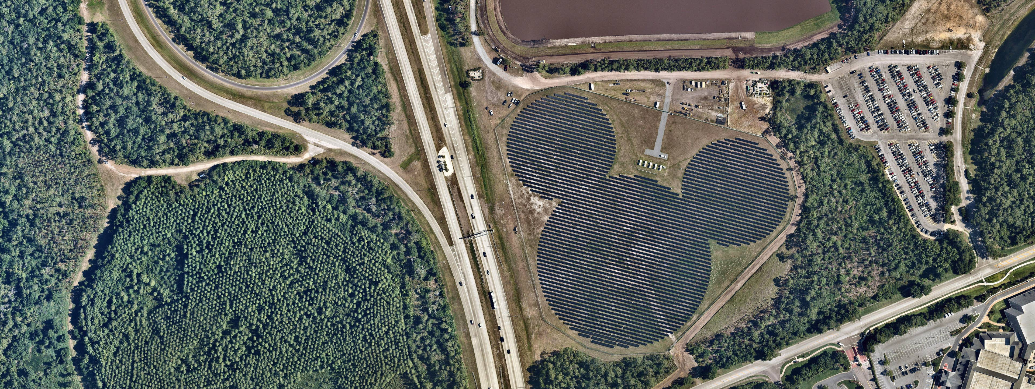
Aerial video images
‘Big and flat’ Plane in the image
Dominated Plane in the Airport
‘Mickey’ Plane in the Field
Introduction
Motivation
Foundation
Approach
Evaluation
Improvement
End

Slide 5
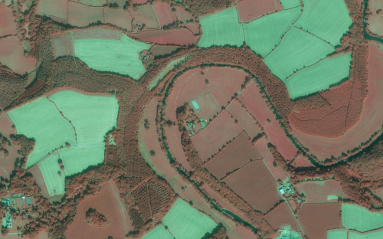
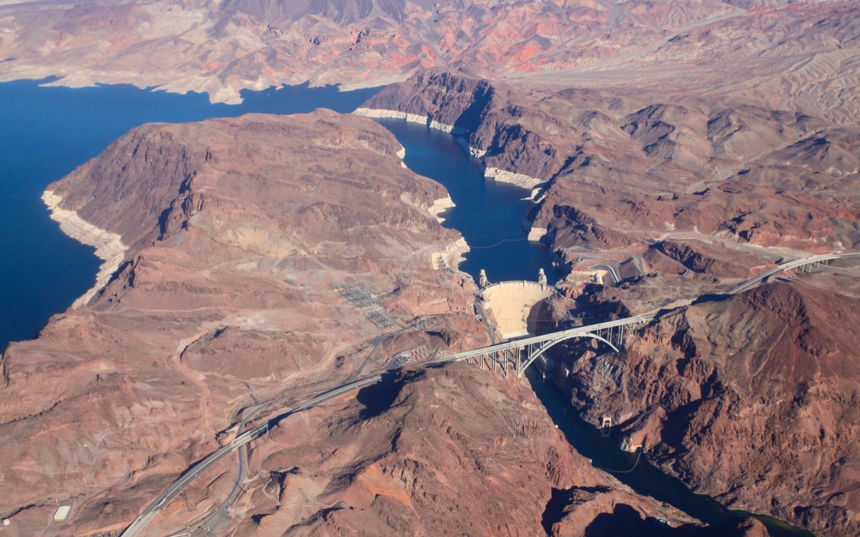
In other cases：not flat enough
Terraces
Mountains
Introduction
Motivation
Foundation
Approach
Evaluation
Improvement
End

Slide 6
Agenda
Introduction
Background
Method
Evaluation
Agenda

Slide 7
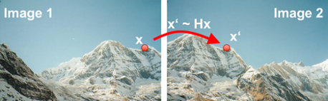
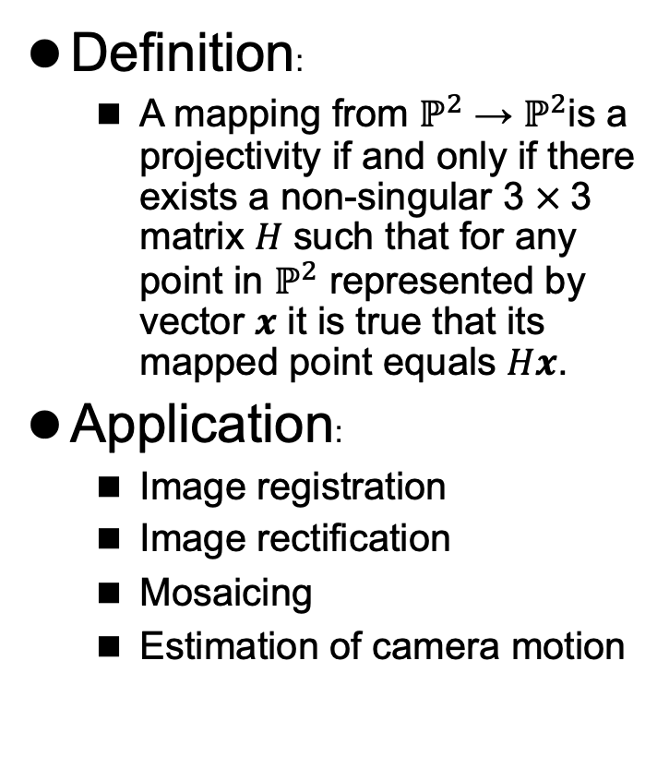
Homography
Definition:
A mapping from $ℙ^{2}$ → $ℙ^{2}$is a projectivity if and only if there exists a non-singular 3 $×$3 matrix 𝐻 such that for any point in $ℙ^{2}$ represented by vector 𝒙 it is true that its mapped point equals 𝐻𝒙.
Application:
Image registration
Image rectification
Mosaicing
Estimation of camera motion
Homography application: Panorama

Slide 8
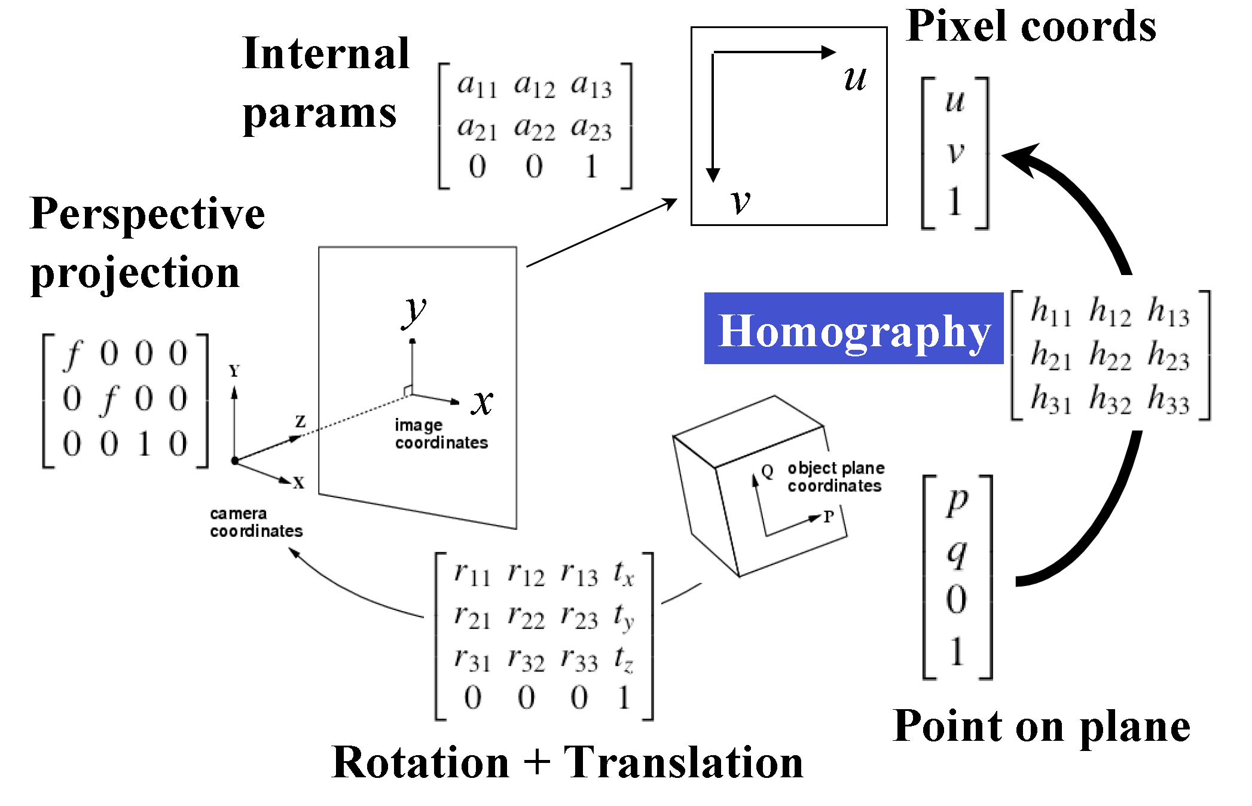
Projection of Points on Planar Surface
Introduction
Motivation
Foundation
Approach
Evaluation
Improvement
End

Slide 9
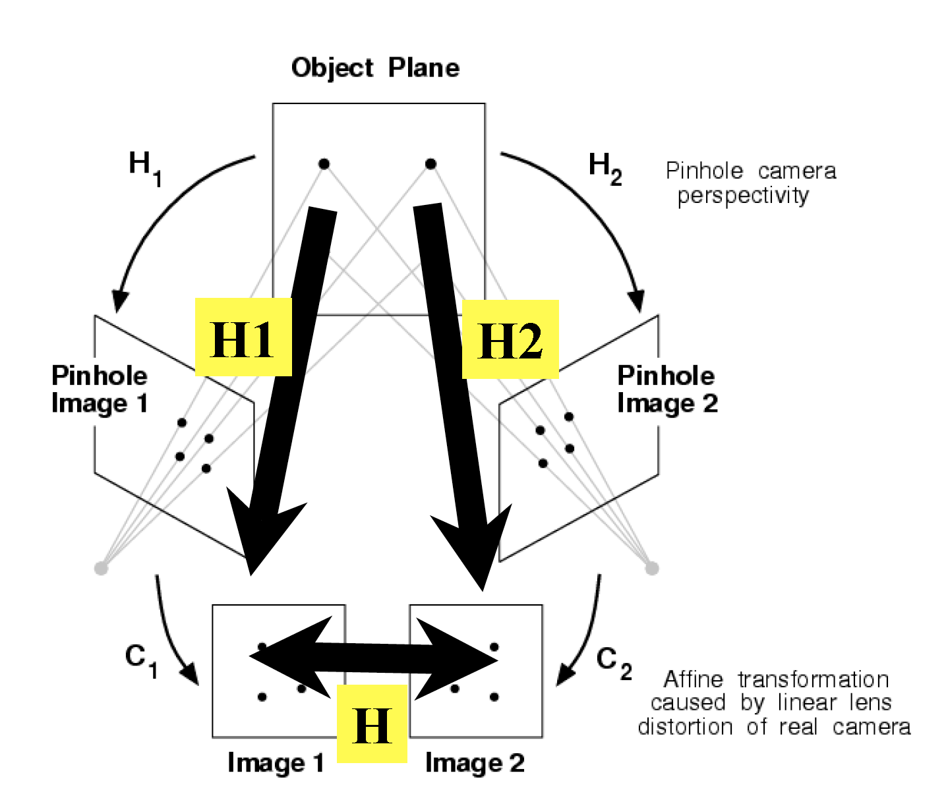
Planar Projection Diagram
Planar Projection Diagram
Introduction
Motivation
Foundation
Approach
Evaluation
Improvement
Summary

Slide 10
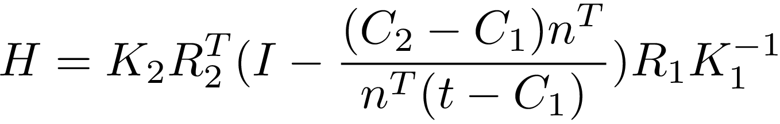
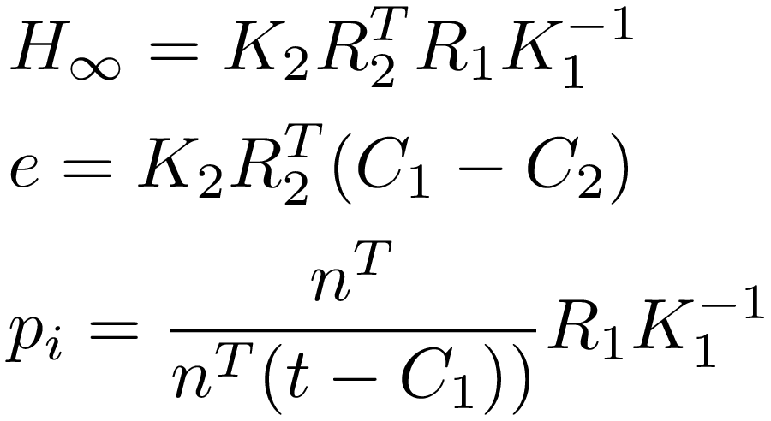
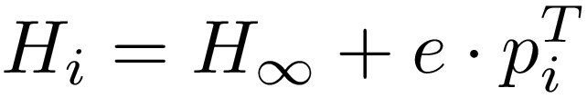
Multiple Homographies
Final formula:
C₁, C₂:center of the camera R₁, R₂:rotation matrix K₁, K₂:calibration matrix n: unit normal of plane t: a point on the plane
Rewrite and Rearrange
Introduction
Motivation
Foundation
Approach
Evaluation
Improvement
End

Slide 11
Agenda
Introduction
Background
Method
Evaluation
Agenda

Slide 12
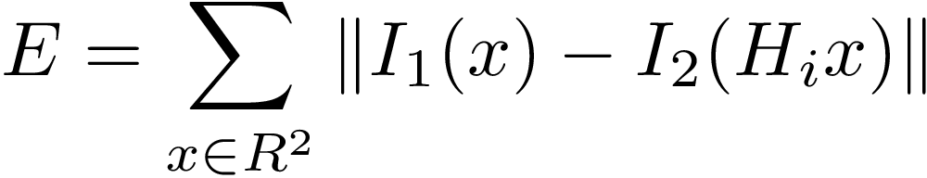
Outline
Minimize Warping Error:
Least Squared Correlation
More accurate H_{i} （i.e. more accurate $H_{∞}$ e and p_{i}）
Calibration the camera (i.e. Refine the parameter C, R and K)
Introduction
Motivation
Foundation
Approach
Evaluation
Improvement
End

Slide 13
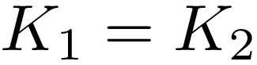
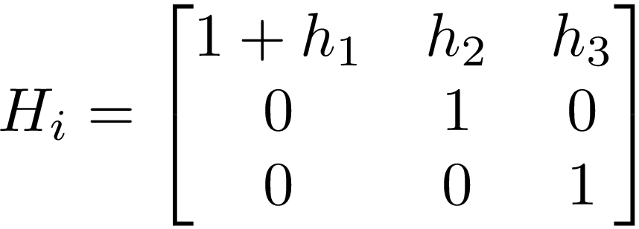
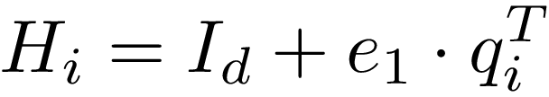
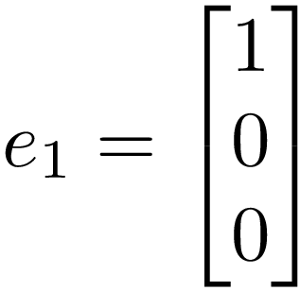
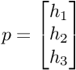
Rectified Stereo Image
Homography matrix :
Among them:
T
T
simplified
for Rectified Image
With:
For plane I in the image:
Introduction
Motivation
Foundation
Approach
Evaluation
Improvement
End

Slide 14
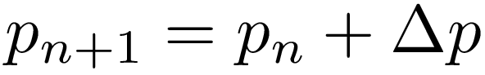
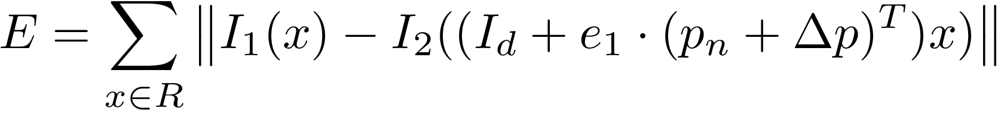



The iterative process (Rectified stereo images)
Reach stopping criterion
Result
Initialization
Start iteration
$$p_{0}$$
$$p_{n}$$
$$p$$
Minimization
2

Slide 15
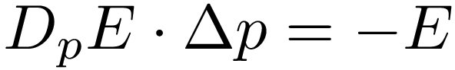
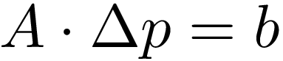
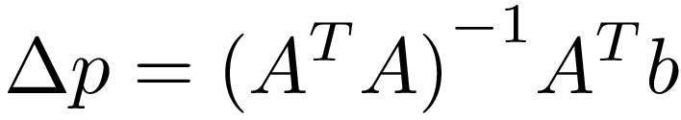
Minimization：Gauss-Newton algorithms
2
Minimize Warping Error:
Linearization
Organized into simple form：
Finally, Solve the equation system:
Introduction
Motivation
Foundation
Approach
Evaluation
Improvement
End

Slide 16
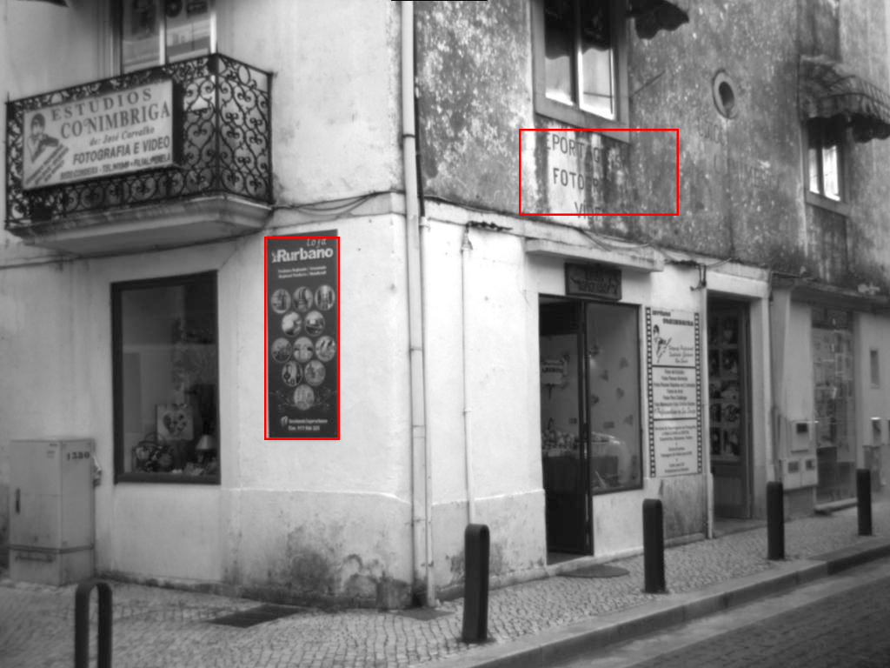
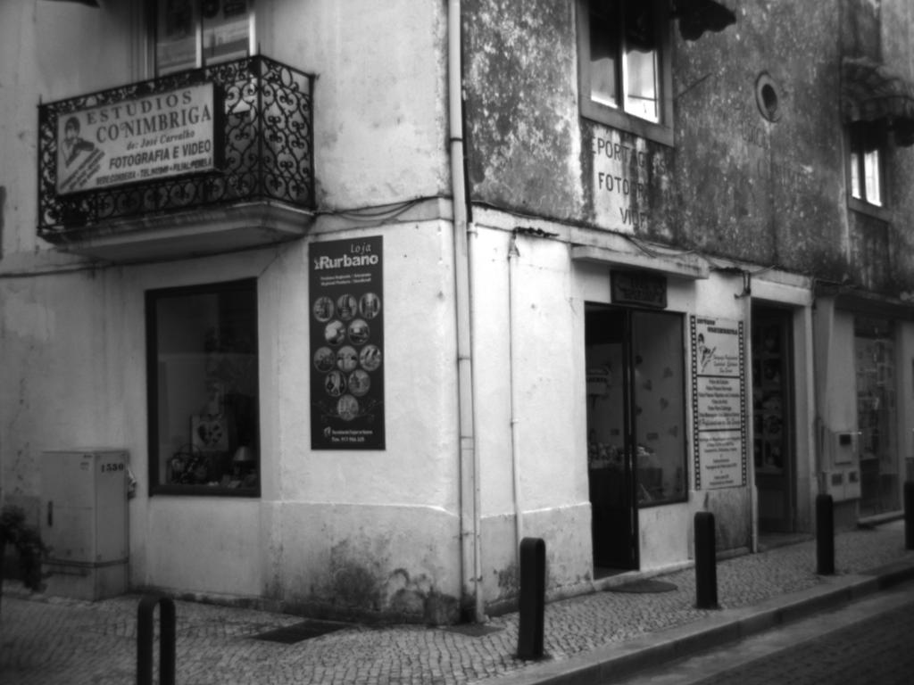
Result of Rectified stereo images
Original Target Image(Left)
Original Template Image(Right)
Introduction
Motivation
Foundation
Approach
Evaluation
Improvement
End

Slide 17
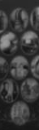
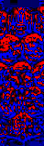

Result of Rectified stereo images (1)
Template image
Warped image
Difference image
Introduction
Motivation
Foundation
Approach
Evaluation
Improvement
End

Slide 18
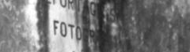
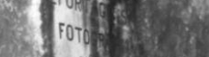
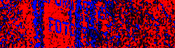

Result of Rectified stereo images (2)
Template image
Warped image
Difference image
Introduction
Motivation
Foundation
Approach
Evaluation
Improvement
End

Slide 19
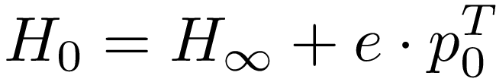
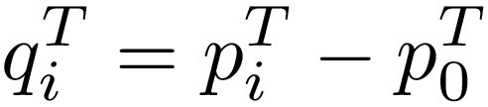
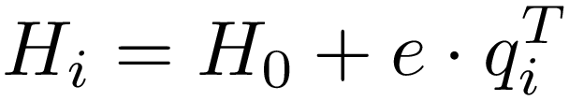
Homography for unrectified Image
Homography matrix :
Homography matrix of plane i for unrectified Image:
Introduction
Motivation
Foundation
Approach
Evaluation
Improvement
End

Slide 20

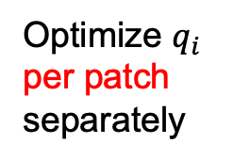



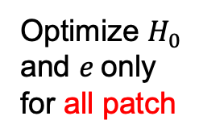
The iterative process (unrectified image)
Optimize $q_{i}$ per patch separately
Initialization
Reach stopping criteria
Result
Start iteration
$H_{0}$,$e$,$q_{i}$
$H_{0}$,$e$,$q_{i}$
$H_{0}$,$e$,$q_{i}$
$H_{0}$,$e$,$q_{i}$
Optimize $H_{0}$ and $e$only for all patch

Slide 21
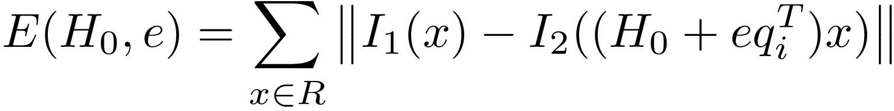
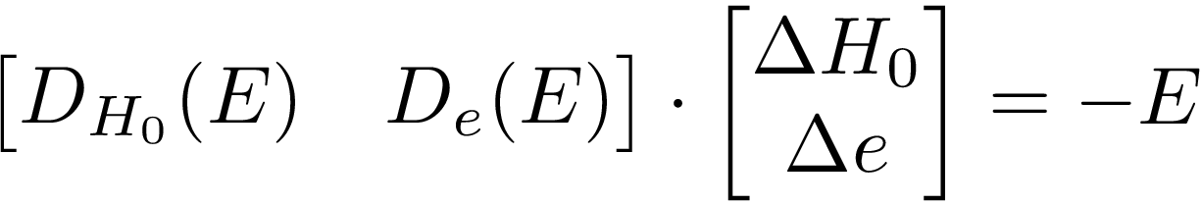
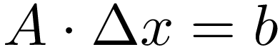
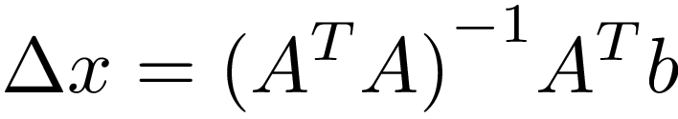
Optimize $H_{0}$ and $e$ (Gauss-Newton Algorithm)
2
Minimize Warping Error:
Linearization
It‘s of the form:
Solve:
Introduction
Motivation
Foundation
Approach
Evaluation
Improvement
End

Slide 22
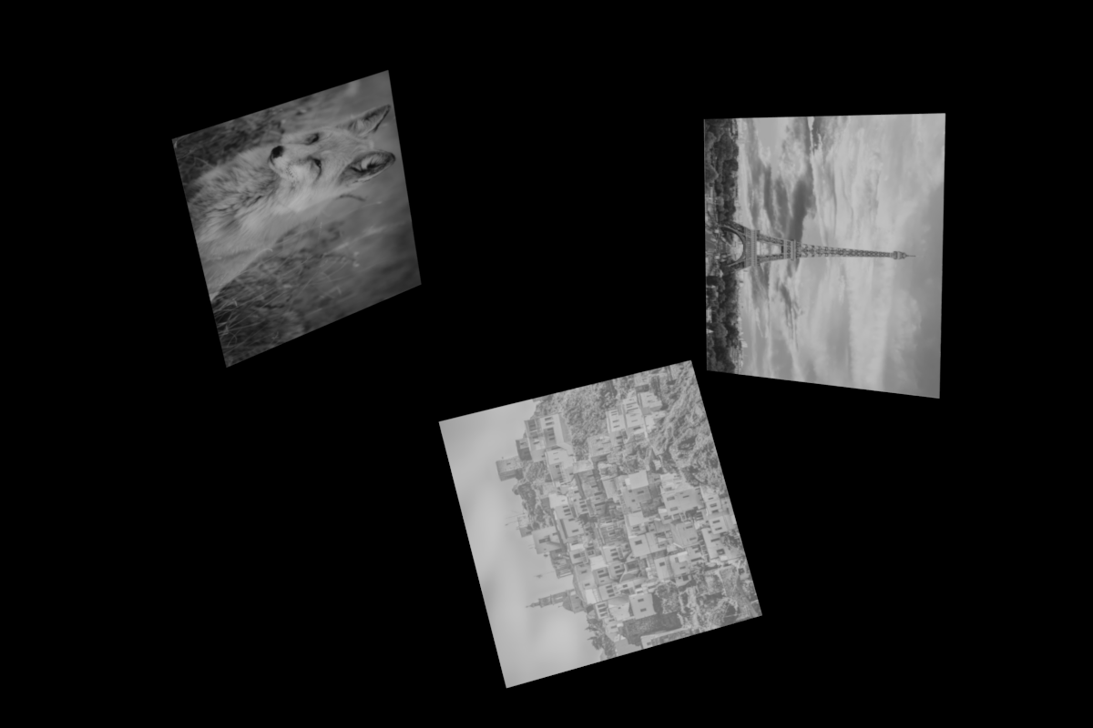
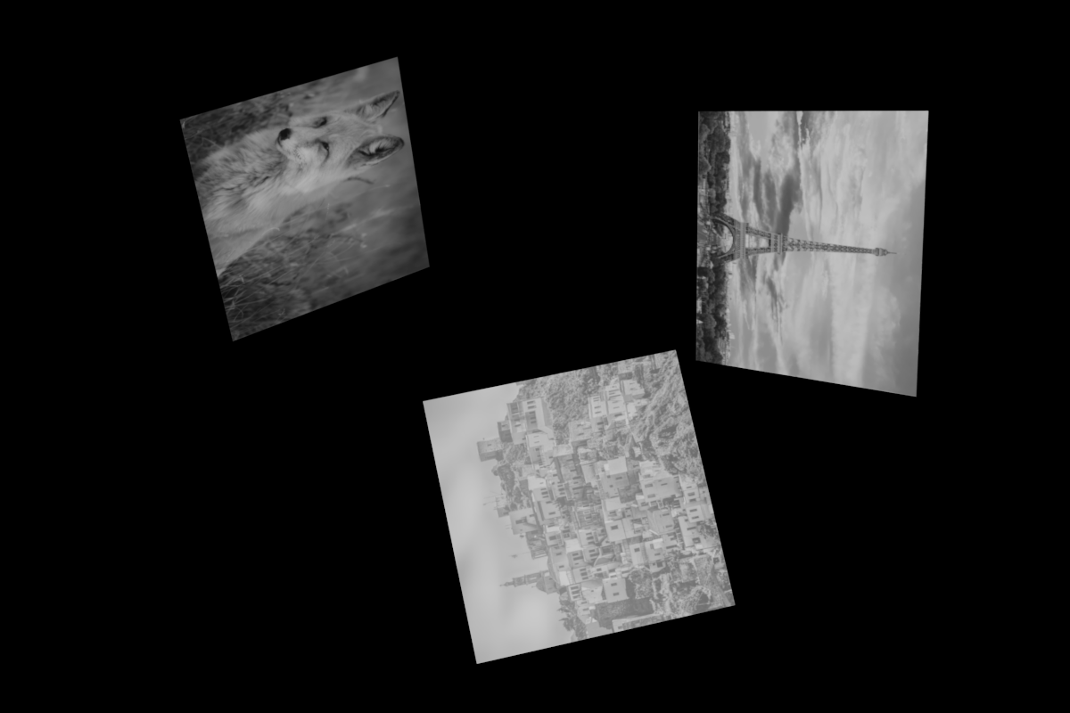
Result of unrectified image
Original Target Image(Left)
Original Template Image(Right)
Introduction
Motivation
Foundation
Approach
Evaluation
Improvement
End
Notes:
(4)

Slide 23
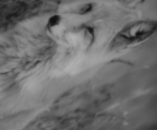
Result of Rectified stereo images (1)
Template image
Introduction
Motivation
Foundation
Approach
Evaluation
Improvement
End

Slide 24

Result of Rectified stereo images (1)
Warped image
Introduction
Motivation
Foundation
Approach
Evaluation
Improvement
End

Slide 25
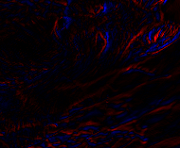
Result of Rectified stereo images (1)
Difference image
Introduction
Motivation
Foundation
Approach
Evaluation
Improvement
End

Slide 26
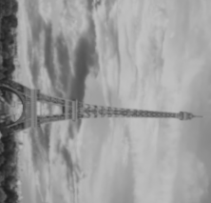
Result of Rectified stereo images (2)
Template image
Introduction
Motivation
Foundation
Approach
Evaluation
Improvement
End

Slide 27

Result of Rectified stereo images (2)
Warped image
Introduction
Motivation
Foundation
Approach
Evaluation
Improvement
End

Slide 28
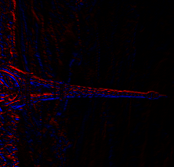
Result of Rectified stereo images (2)
Difference image
Introduction
Motivation
Foundation
Approach
Evaluation
Improvement
End

Slide 29

Result of Rectified stereo images (3)
Template image
Introduction
Motivation
Foundation
Approach
Evaluation
Improvement
End

Slide 30

Result of Rectified stereo images (3)
Warped image
Introduction
Motivation
Foundation
Approach
Evaluation
Improvement
End

Slide 31
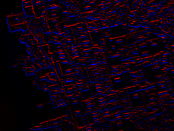
Result of Rectified stereo images (3)
Difference image
Introduction
Motivation
Foundation
Approach
Evaluation
Improvement
End

Slide 32
Agenda
Introduction
Approach
Evaluation
Future Improvement
Agenda

Slide 33
Evaluation
Dataset with ground truth:
1. Public datasets
2. Self-built datasets
Test with the dataset with ground truth
Introduction
Motivation
Foundation
Approach
Evaluation
Improvement
End

Slide 34
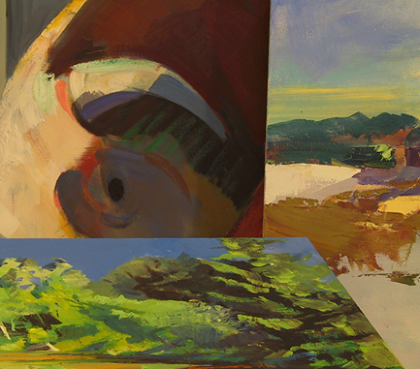
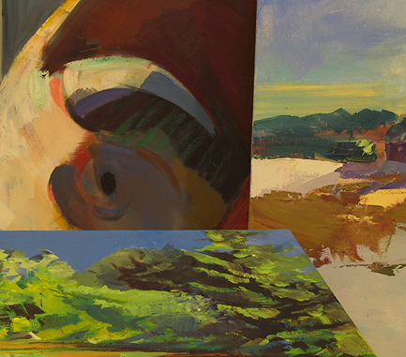
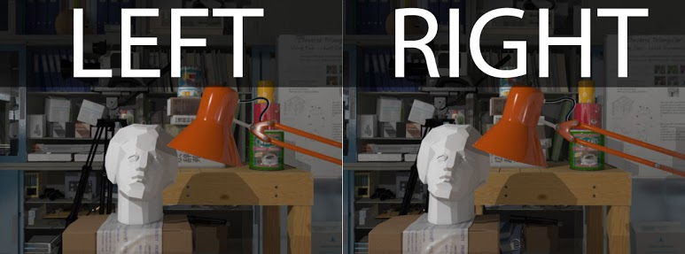
Public Datasets
Middlebury Stereo Vision Datasets
New Tsukuba Stereo Dataset
LEFT
RIGHT
Unsuitable:
Only Rectified stereo image
Unsuitable:
Not enough big plane
Introduction
Motivation
Foundation
Approach
Evaluation
Improvement
End

Slide 35
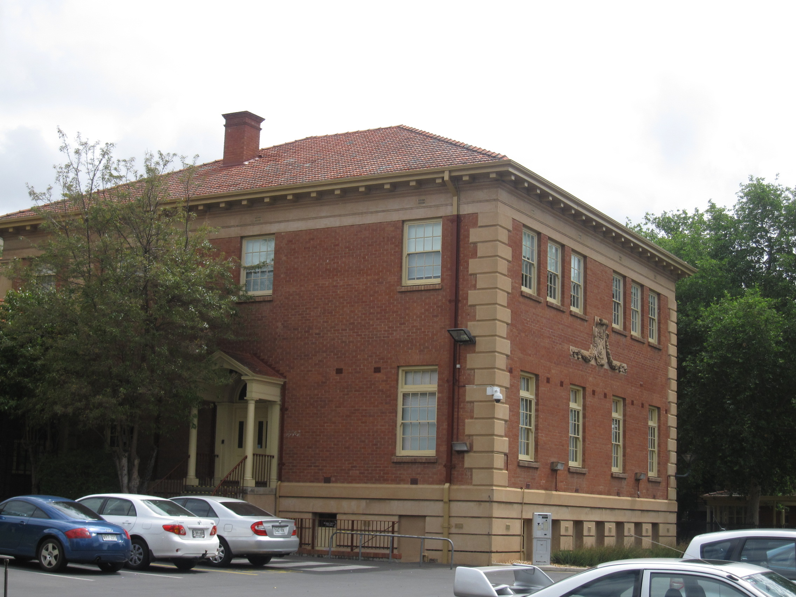
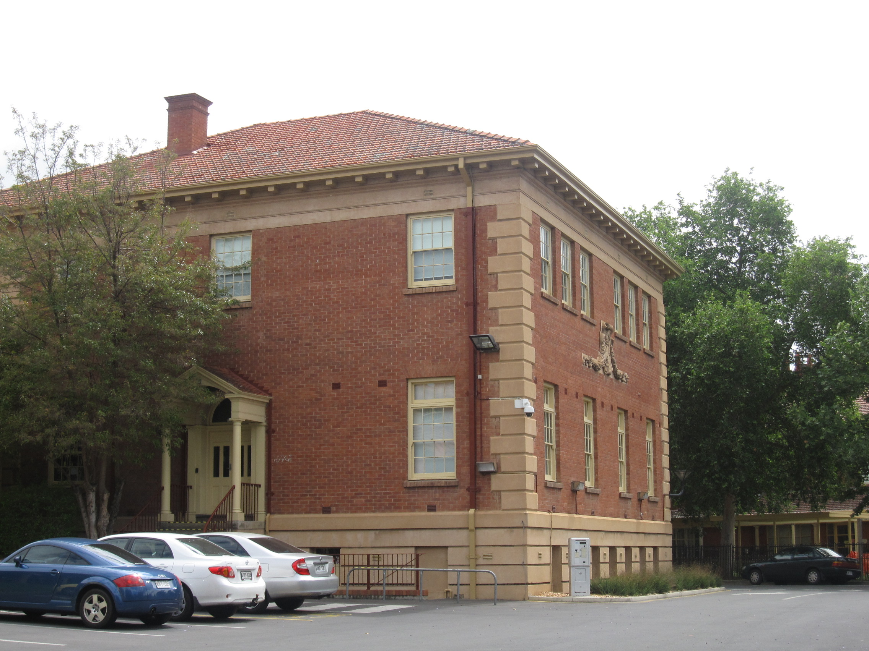
AdelaideRMF
LEFT
RIGHT
Introduction
Motivation
Foundation
Approach
Evaluation
Improvement
End

Slide 36



Self-built Datasets
Image from left camera
Image from right camera
Test Scene in blender
Introduction
Motivation
Foundation
Approach
Evaluation
Improvement
End

Slide 37




Evaluation standard
PSNR (Peak signal-to-noise ratio)
RMSD (Root mean squared displacement)
After the estimating homography matrix H_{n} is got, a warped image K(i, j) can be calculated. I(i, j) means the template image.
With ground truth homography matrix H_{ngt} and the estimated homgraphy matrix H_{n} for patch n in the image, two warped images can be got:
$y_{ij}^{′}=H_{ngt} ∙x_{ij}$
$y_{ij}=H_{n} ∙x_{ij}$
RMSD is define
$$RMSD= \sqrt{\frac{1}{n} \sum_{x_{ij}∈ROI}{{\left\|y_{ij} − y_{ij}^{′}\right\|}^{2}}}$$
for all pixel in the patch n.
PSNR is defined as :
Where ${MAX}_{I} is \text{the} \text{maximum} \text{possible} \text{pixel} \text{value} \text{of} \text{the} \text{image}$. And The typical value for the PSNR for image registration are between 30 and 50 dB, where higher is better.

Slide 38

Result of Middlebury Stereo Vision Dataset
Patch | PSNR(dB) | RMSD(pixel)
(1) | 37.5768 | 2.252596
(2) | 40.4451 | 0.647761
(3) | 45.9941 | 0.184386
(4) | 42.4099 | 0.536102
(5) | 47.7764 | 0.954197
(6) | 38.3245 | 0.895281
Template and transformed plane patches in Middlebury Stereo Vision Datasets
Evaluation Result
Introduction
Motivation
Foundation
Approach
Evaluation
Improvement
End

Slide 39

Result of Middlebury Stereo Vision Dataset
Patch | PSNR(dB) | RMSD(pixel)
(1) | 46.9869 | 0.203423
(2) | 41.8912 | 1.123935
(3) | 32.6315 | 1.523684
(4) | 41.8892 | 0.358562
(5) | 36.9338 | 1.111534
(6) | 49.0576 | 0.102031
Template and transformed plane patches in Middlebury Stereo Vision Datasets
Evaluation Result
Introduction
Motivation
Foundation
Approach
Evaluation
Improvement
End

Slide 40


Result of Self-built Stereo Images
Original Target Image(Left)
Original Template Image(Right)
Introduction
Motivation
Foundation
Approach
Evaluation
Improvement
End

Slide 41

Result of Self-built Stereo Images
Patch | PSNR(dB) | RMSD(pixel)
(a) | 49.1514 | 0.044846
(b) | 66.9878 | 0.003704
(c) | 56.9686 | 0.017901
Template and transformed plane patches in Middlebury Stereo Vision Datasets
Evaluation Result
Introduction
Motivation
Foundation
Approach
Evaluation
Improvement
End

Slide 42

Result of Self-built Normal Images (1)
Original Target Image(Left)
Original Template Image(Right)
Introduction
Motivation
Foundation
Approach
Evaluation
Improvement
End
Notes:
(3)

Slide 43

Result of Self-built Normal Images (1)
Patch | PSNR(dB) | RMSD(pixel)
(a) | 36.1911 | 0.291320
(b) | 40.2400 | 0.131122
(c) | 40.4210 | 0.189493
All Patch | - | 0.202340
Template and transformed plane patches in Middlebury Stereo Vision Datasets
Evaluation Result
Introduction
Motivation
Foundation
Approach
Evaluation
Improvement
End

Slide 44


Result of Self-built Normal Images (2)
Original Target Image(Left)
Original Template Image(Right)
Introduction
Motivation
Foundation
Approach
Evaluation
Improvement
End
Notes:
(1)

Slide 45

Result of Self-built Normal Images (2)
Patch | PSNR(dB) | RMSD(pixel)
(a) | 29.3573 | 0.304703
(b) | 40.4581 | 0.208013
(c) | 38.8231 | 0.344370
All Patch | - | 0.288475
Template and transformed plane patches in Middlebury Stereo Vision Datasets
Evaluation Result
Introduction
Motivation
Foundation
Approach
Evaluation
Improvement
End

Slide 46


Result of Self-built Normal Images (3)
Original Target Image(Left)
Original Template Image(Right)
Introduction
Motivation
Foundation
Approach
Evaluation
Improvement
End
Notes:
(1)

Slide 47

Result of Self-built Normal Images (3)
Patch | PSNR(dB) | RMSD(pixel)
(a) | 44.9857 | 0.186577
(b) | 38.3061 | 0.130046
(c) | 41.5518 | 0.369888
All Patch | - | 0.215594
Template and transformed plane patches in Middlebury Stereo Vision Datasets
Evaluation Result
Introduction
Motivation
Foundation
Approach
Evaluation
Improvement
End

Slide 48
Result of Self-built Normal Images (4)
Original Target Image(Left)
Original Template Image(Right)
Introduction
Motivation
Foundation
Approach
Evaluation
Improvement
End
Notes:
(1)

Slide 49

Result of Self-built Normal Images (4)
Patch | PSNR(dB) | RMSD(pixel)
(a) | 46.1314 | 0.126497
(b) | 44.7784 | 0.087420
(c) | 32.3565 | 0.136024
All Patch | - | 0.117115
Template and transformed plane patches in Middlebury Stereo Vision Datasets
Evaluation Result
Introduction
Motivation
Foundation
Approach
Evaluation
Improvement
End

Slide 50
Agenda
Introduction
Approach
Evaluation
Future Improvement
Agenda

Slide 51
Feature improvement
I. Aliasing Handling
II. Robust Estimation
III. Better Initialization
IV. Post Processing
Introduction
Motivation
Foundation
Approach
Evaluation
Improvement
End

Slide 52
THANK YOU FOR YOUR ATTENTION !
QUESTIONS & COMMENTS ?
Introduction
Motivation
Foundation
Approach
Evaluation
Improvement
End

Slide 53
Back-Up
Question 1:
Question 2:
Question 3:
Question 4:

